Slide 1

INGLÉS PARA EL TRABAJO
Tema 1: The Verb to be and Present Simple : Review
Todas las carreras

Slide 2
Elabora oraciones y preguntas utilizando los pronombres personales, el Verbo to be y el Present Simple para describir actividades diarias.

Slide 3
TEMA 1:
The Verb to be and Present Simple : Review
SUBTEMAS:
Subject Pronouns
Common Verbs
Review of the Verb to be and Present Simple in all forms

Slide 4
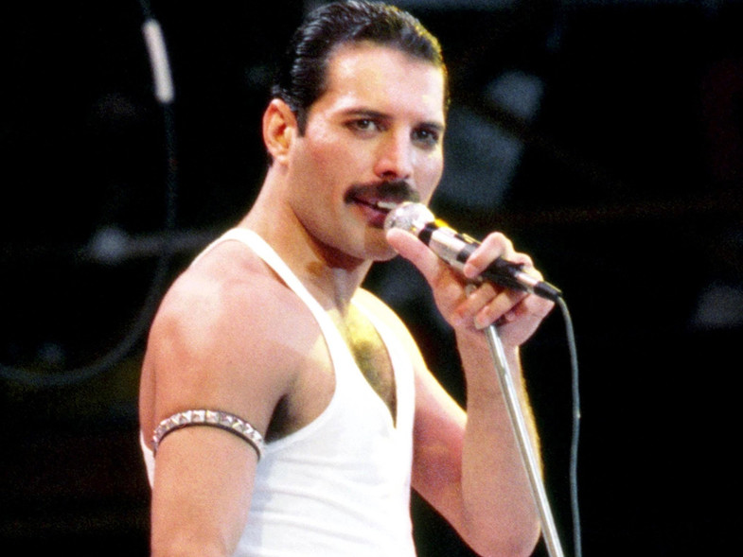
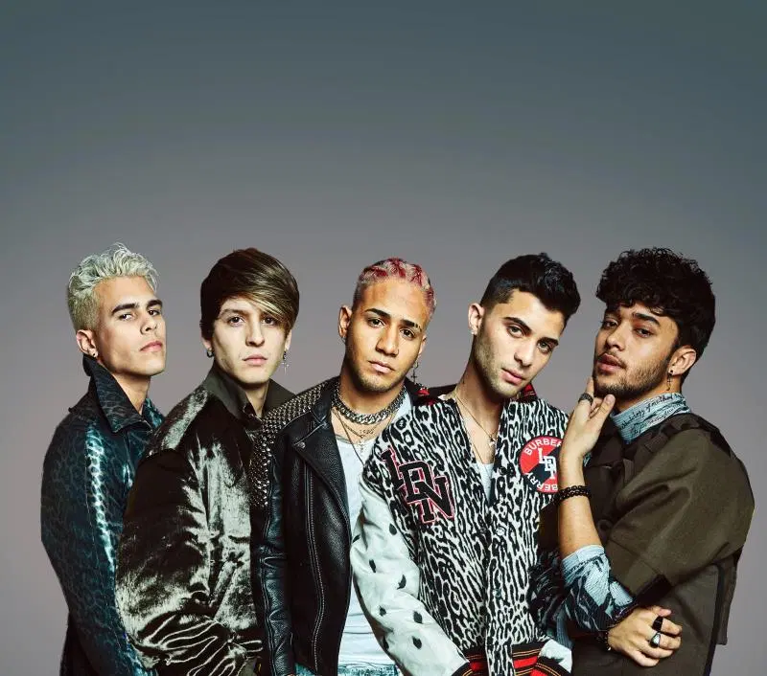
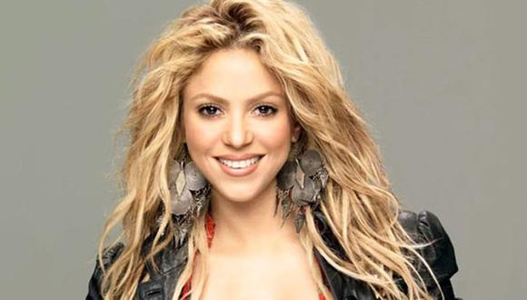
Inglés para el Trabajo
Subject Pronouns
Look at the pictures and answer:
What can you see? Who are they?

Slide 5
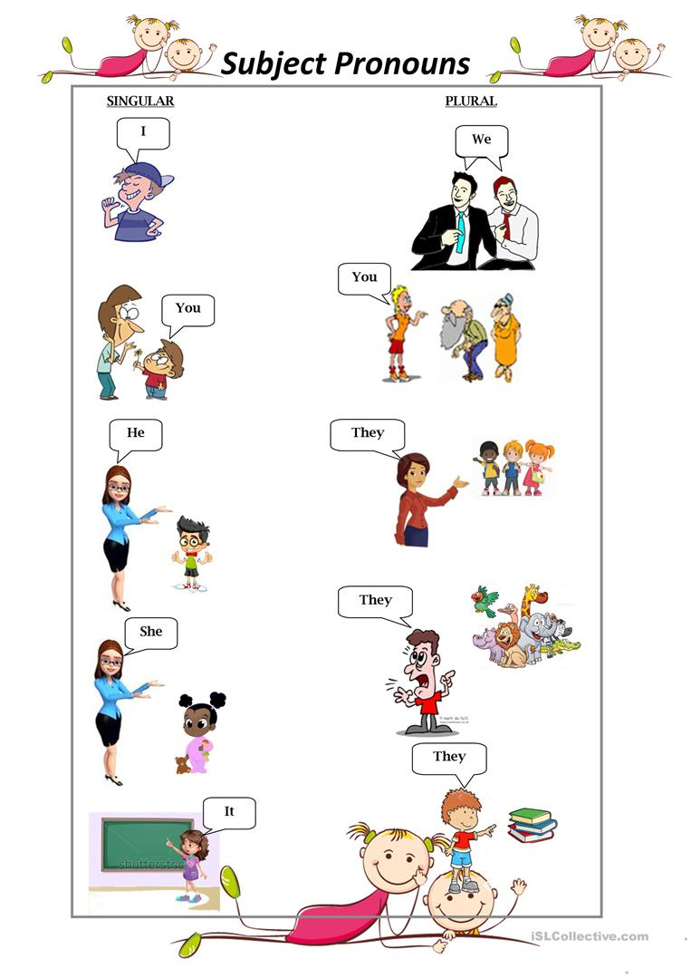

Inglés para el Trabajo
Subject Pronouns
A pronoun is a short word that replaces a noun in order to make speaking and writing English
less repetitive. Personal pronouns are not limited to people and can also refer to animals and objects.

Slide 6
Inglés para el Trabajo
Subject Pronouns
A pronoun is a short word that replaces a noun in order to make speaking and writing English
less repetitive. Personal pronouns are not limited to people and can also refer to animals and
objects.

Slide 7
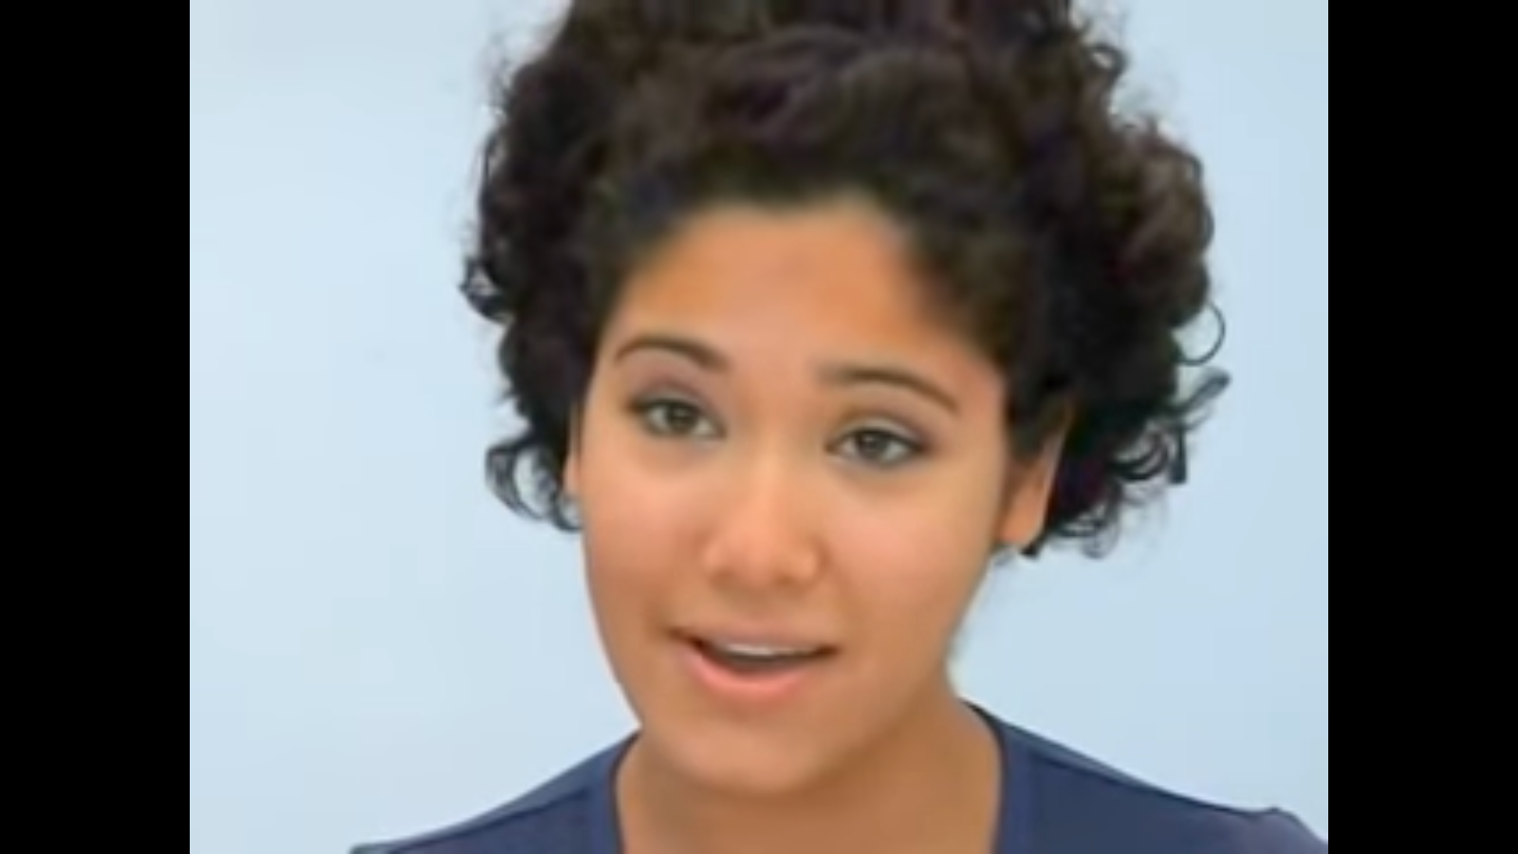
Inglés para el Trabajo
The Verb to be
Watch the video and answer:
Who is she ?
What is she talking about?
https://www.youtube.com/watch?v=jXVujrUF9F0&t=27s

Slide 8

Inglés para el Trabajo
The Verb to be
We use the verb to be to talk about names ,age, nationalities,Jobs etc.It means that we use the Ver b to be when we talk about Personal Information.We have three verbs am,is and are.
Subject Pronouns Verb to be
I am
He
She is
It
We
You are
They

Slide 9
Inglés para el Trabajo
The Verb to be
We can use the Verb to be with this structure .First, we use the pronoun or and then the verb to be am is are
and the complement like ages,jobs,nationalities,etc. And we can make sentences with the Verb to be in this
form:
+ VERB TO BE + C (names, ages, jobs, etc.).
AFFIRMATIVE CONTRACTION
I am a student. I’m a student.
He is 18. He’s 18.
You are happy. You’re happy.

Slide 10

Inglés para el Trabajo
The Verb to be
Also,we can make sentences with the Verb to be in this form:
NEGATIVE CONTRACTION
I am not a student. I’m not a student.
He is not 18. He isn’t 18.
You are not happy. You aren’t happy.

Slide 11
Inglés para el Trabajo
The Verb to be
Also,we can make sentences with the Verb to be in this form:
YES / NO QUESTIONS
You are a doctor.
Are you a doctor?
Yes,I am / No,I’m not.
Is he 18 ?
Yes,he is/No he isn’t.

Slide 12
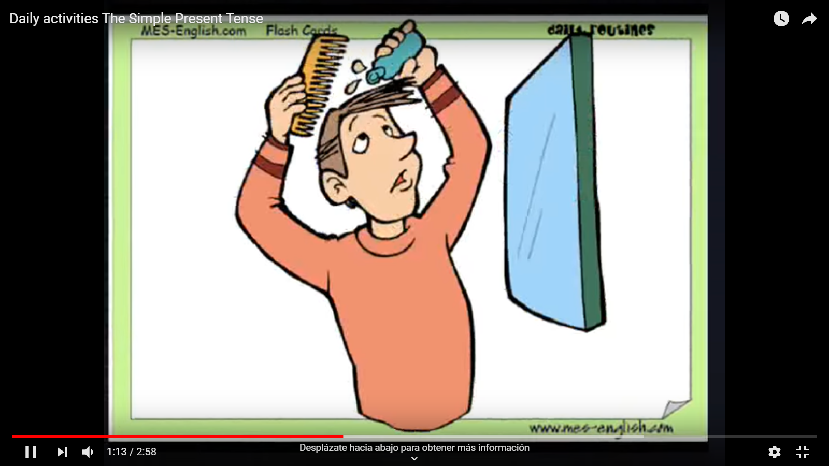
Inglés para el Trabajo
Common Verbs
Look and answer:
What is this video talking about?
https://www.youtube.com/watch?v=yWccPqg1DbI

Slide 13
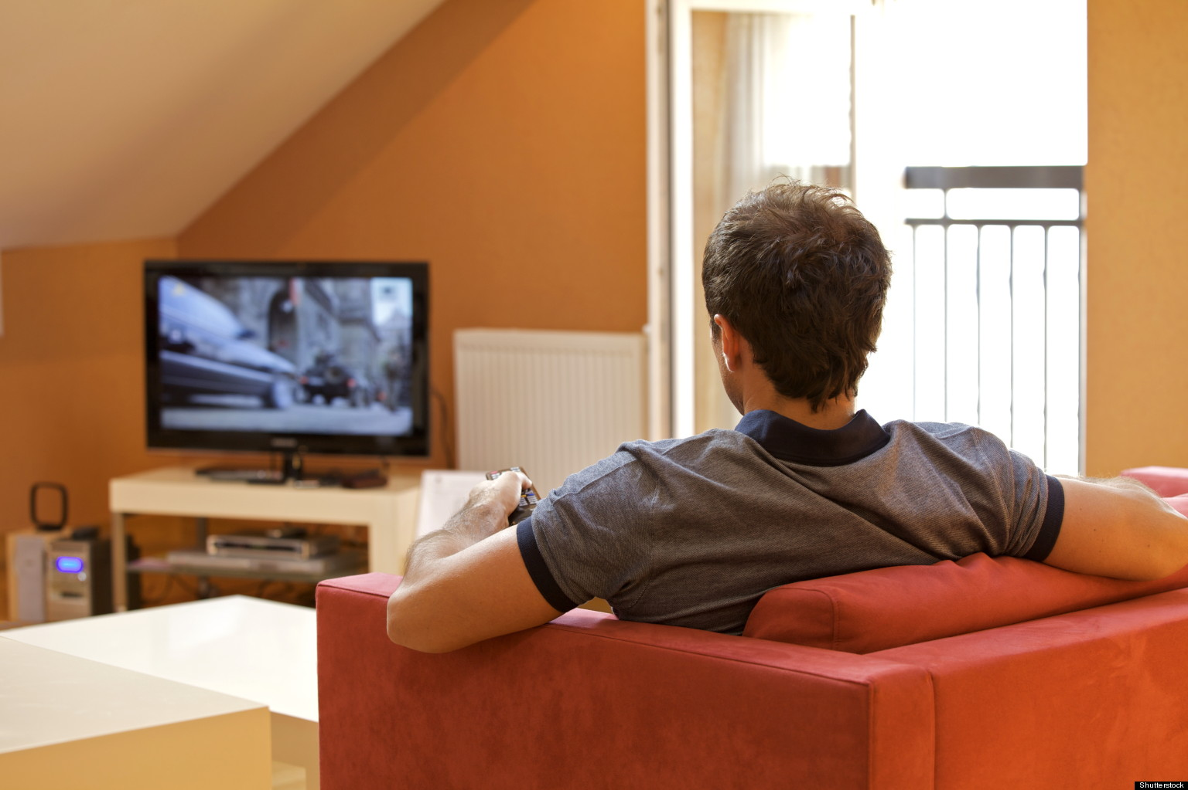
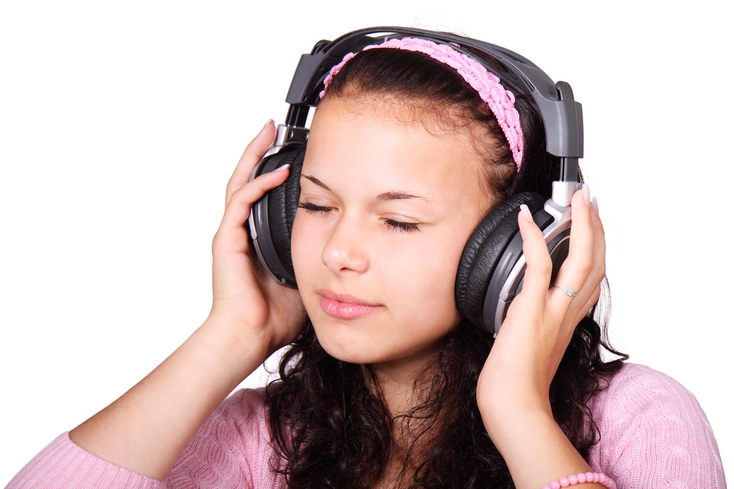
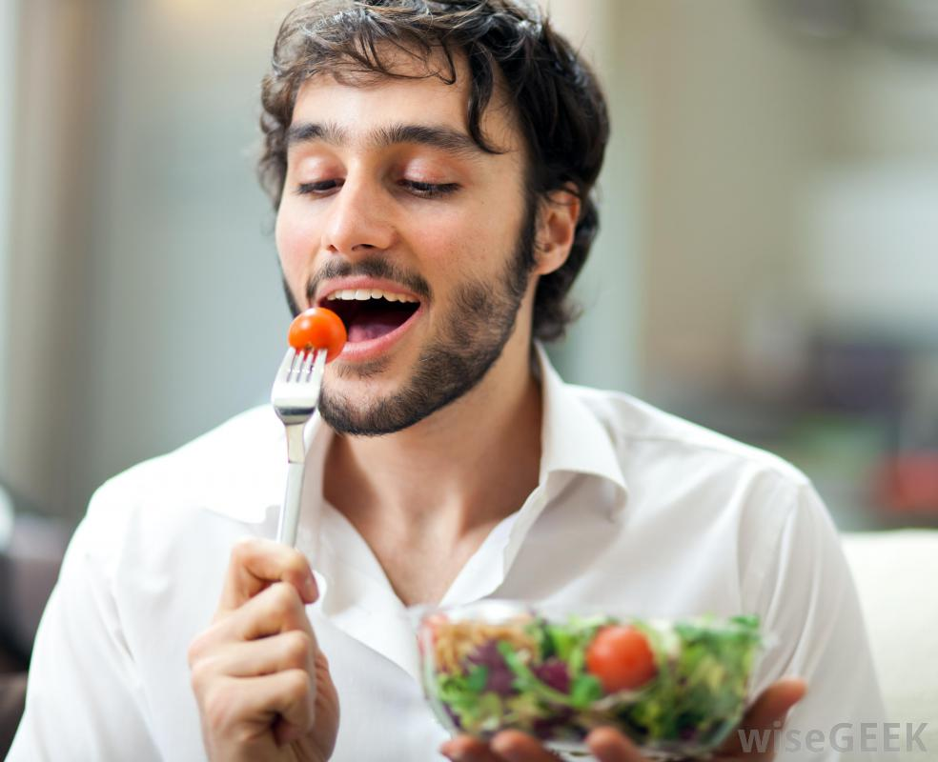
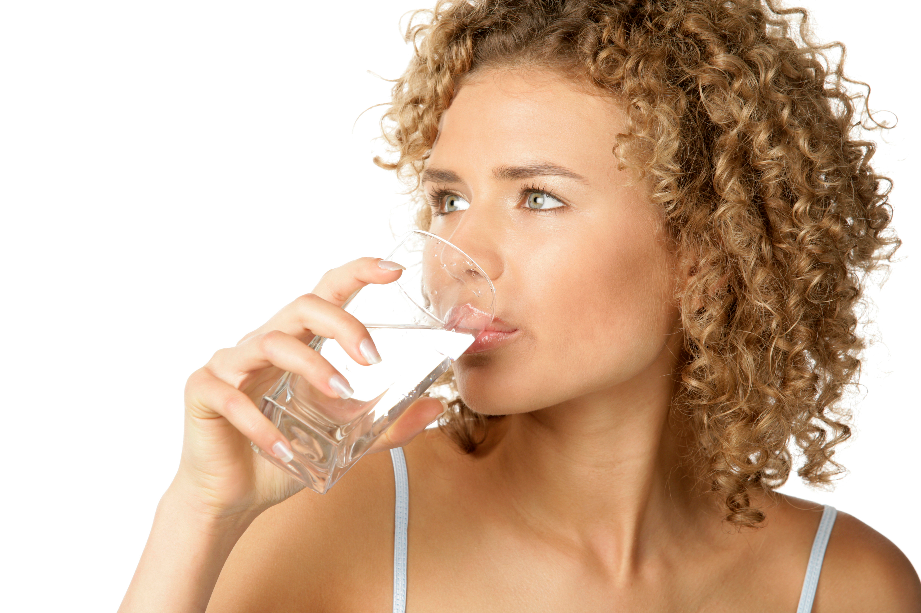

Inglés para el Trabajo
Common Verbs
Listen and repeat:
watch TV
Listen to music
eat
drink
study

Slide 14
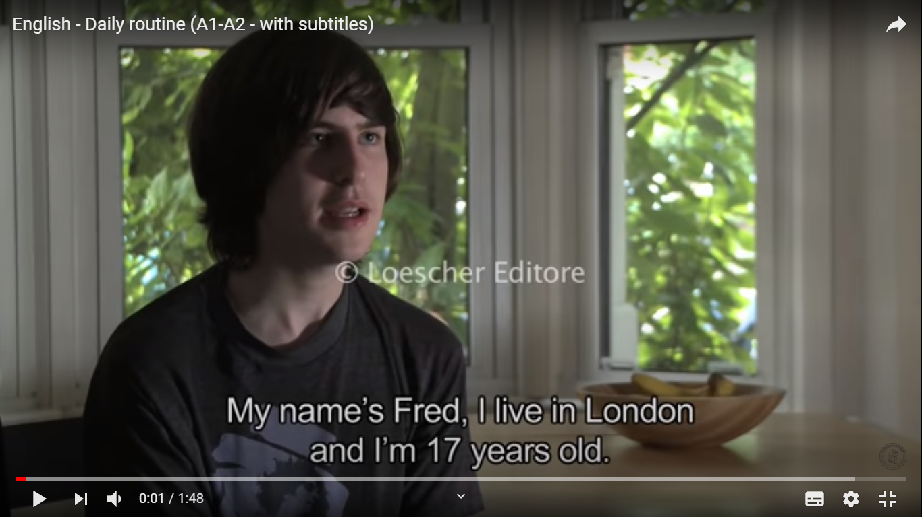
Inglés para el Trabajo
Present Simple
Look and answer:
What can you see?
What is this video talking about?
https://www.youtube.com/watch?v=RP1AL2DU6vQ

Slide 15
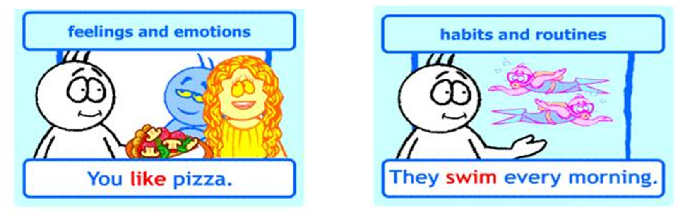
Inglés para el Trabajo
Simple Present
We use Simple Present when we talk about:

Slide 16

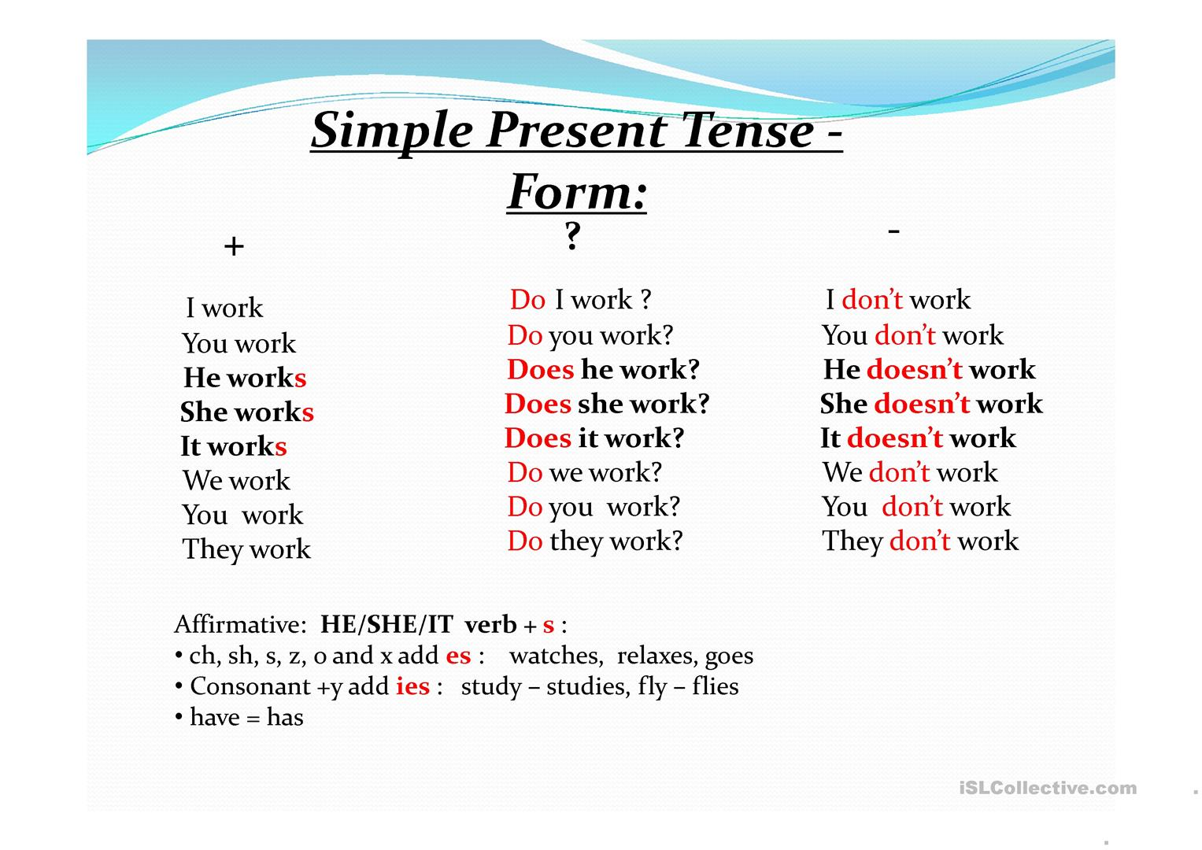
Inglés para el Trabajo
Simple Present
We use Simple Present in this forms:

Slide 17
Virtual Activity

Slide 18
Inglés para el Trabajo
Virtual Activity
Write the correct Subject Pronoun.
book ……………………
Friends …………………..
Giany …………………..
Parents ………………….
David ………………….
Cat ………………….

Slide 19

Inglés para el Trabajo
Virtual Activity
Read and complete with the correct verb.
On Sunday, Tom (get)……….. up at 10 o'clock. Then he reads his newspaper in the kitchen. He (have)……….. breakfast at 11.30 and then he telephones his mother in Scotland.
In the afternoon, at 1.00, Tom plays tennis with his sister and after that, they eat dinner in a restaurant. At 6.00, Tom (swim)……….. for one hour and then he goes by bike to his brother´s house. They (talk)………….. and listen to music.
Tom watches television in the evening and (drink)………. a glass of Jack Daniel's whiskey. He goes to bed at 11.30.

Slide 20
Inglés para el Trabajo
Virtual Activity
Now ,say true or false according to the text.
1. Does Tom get up at 10am on Sundays?
True
False
2. Does he read the newspaper in the lounge.
True
False
3. Does his father live in Scotland?
True
False

Slide 21
Thanks!

